Slide 1
The effect of scale in the apprehension of electoral nationalism: the case of Catalonia
Rodrigo Rodrigues-Silveira (University of Salamanca)
Hugo Marcos Marné (University of St. Gallen)

Slide 2
Structure
The problem: Why we need to be aware of the scale?
Our proposal
Empirical approach to the problem
Some preliminary results

Slide 3
Why we need to be aware of the scale?

Slide 4
The comparative strategies of electoral geography
Analysis |  |  |  | Implementation
Level | Type | Freq. |  | Spatial | Time
Municipal | Between units | High |  | Easy | Easy
Mid-large cities/capitals | Within units | medium |  | Varies (level of detail) | Difficult
Conurbations / Metropolitan areas | Between and within units | Low |  | Varies (level of detail) | Easy (between) Difficult (within)

Slide 5
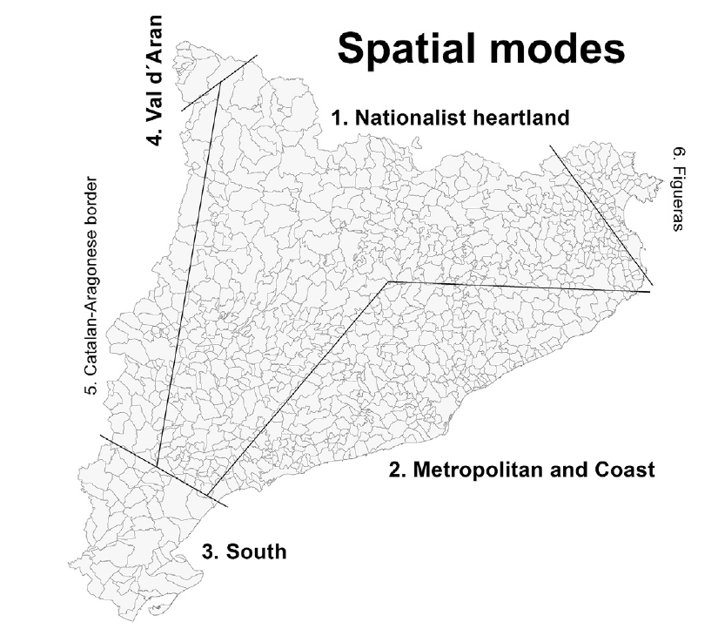
Spatial modes of support for the nationalism in Catalonia
Source: Lepic, 2017.
(or Tabarnia)

Slide 6
The municipal scale: Ups and downs
Advantages
  Easier to compare across different space and time units
  No need for further theoretical reflection on the spatiality of the vote
  No further knowledge on GIS or spatial analysis required
  It is relatively simple to identify clear territorial clustering of nationalist support (Nationalist heartland vs Tabarnia)
Disadvantages
  Scale up: Ignores the territoriality behind electoral contests (the size and spatial structure of electoral districts)
  Scale down: Hides internal heterogeneity within municipalities

Slide 7
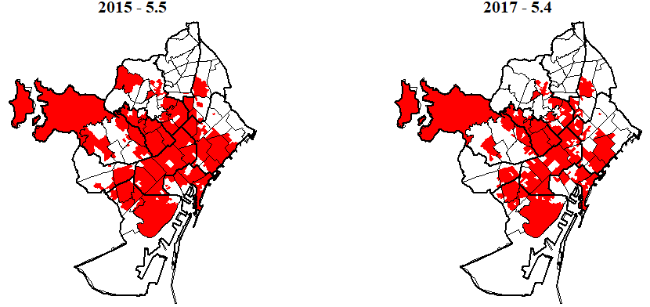
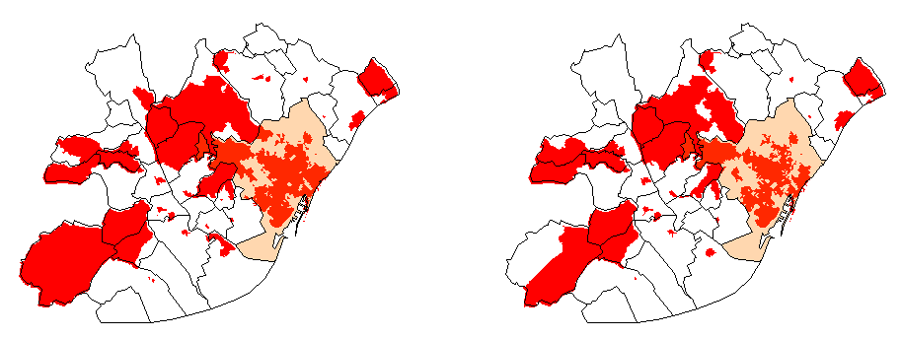
Support for the Nationalism
in Barcelona and the AMB
(electoral precincts ABOVE Cat. average)

Slide 8
Our proposal

Slide 9
Our proposal
  To study the role of inframunicipal/metropolitan scale on the formation of (nationalist) political majorities.
  Why Catalonia:
    Spatial disaggregation of data at very fine-grained levels
    Allows testing for the homogeneity of the national political community
    Territory as a “motherland”?
    The salience of Barcelona Metropolitan Area to the final political outcomes in Catalonia. ** This is a particularly important dimension, although understudied

Slide 10
Our proposal
  Scale is fundamental to understand electoral majorities, because:
  In multimember PR districts, variations within big cities or metropolitan areas can impact on the overall political success of nationalism.
  More concretely…
  In contexts of high district magnitude and demographic agglomeration, infra-municipal clusters can be decisive to nationalist parties to achieve the legislative majorities required to form government.

Slide 11
Our proposal
  Some starting assumptions:
    Municipal aggregates can hide a great deal of internal heterogeneity.
    This heterogeneity takes the form of clusters gathering predominantly nationalist and centralist areas (precincts, neighbourhoods, or districts).
    When municipalities are large urban settlements or are embedded into conurbations, large district magnitude increases the political salience of the infra-municipal scale.
    Infra-municipal clusters of nationalism in “centralist majority” municipalities can impact significantly on the chances of nationalist parties to form government.

Slide 12
Empirical approach to the problem

Slide 13
Testing our assumptions
  Two empirical strategies to achieve this:
  1. Counterfactual analysis
    Estimating the number of seats that would be won by the votes cast to nationalist parties in clearly nationalist precincts (secciones electorales).
    Discarding the vote on those precincts that fall within the “nationalist heartland”.
  2. Statistical/Spatial analysis
    Modelling potential explanations and testing explicitly the effect of differences in scale (comparative models at municipal and infra-municipal scales).
    Analysis of spatial clustering of vote patterns in Catalonia conurbations to identify statistically significant nationalist enclaves within “non-nationalist” areas.

Slide 14
Measurement
Our proposal (Rodrigues-Silveira, Marcos Marné y Gutiérrez Díaz)
Combine survey data on support for nationalism with electoral results
We use the average scores for all respondents (not just the supporters own classification)
We use the average for each electoral district (province), instead of all Catalonia.
We aggregate at different scales weighting district-level nationalism averages by the electoral support of each party.

Slide 15
Some preliminary results

Slide 16
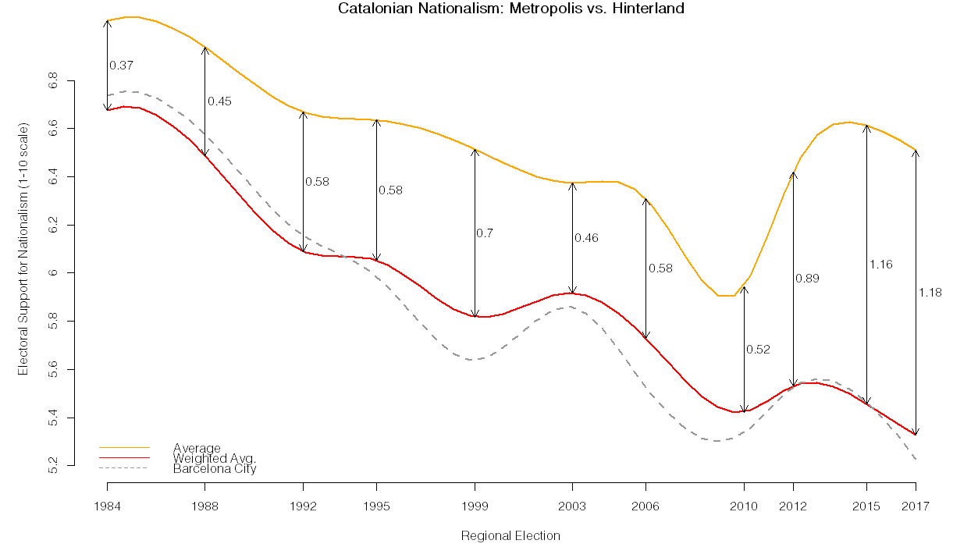
Between-area polarization (municipalities)

Slide 17
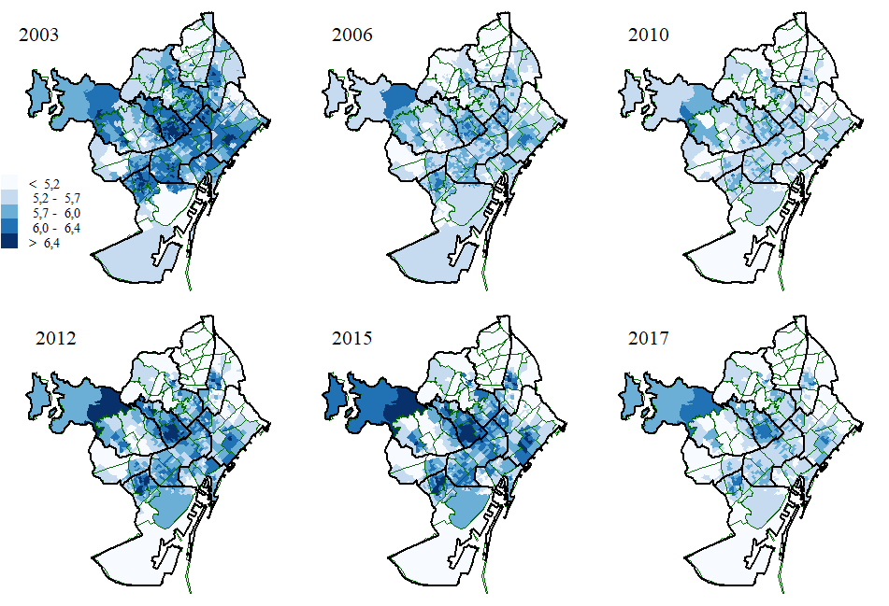
Support for the Nationalism in Barcelona
(electoral precincts)
The game of margins

Slide 18
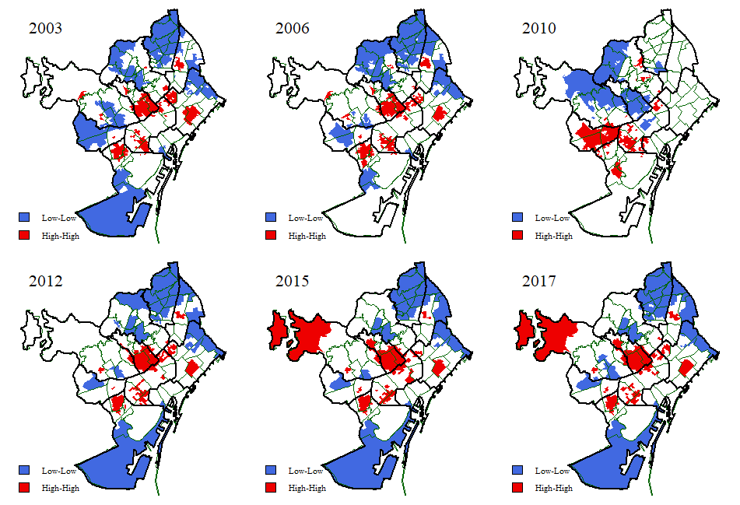
Support for the Nationalism in Barcelona
(clusters of electoral precincts)

Slide 19
Thank you for your attention!

